Slide 1
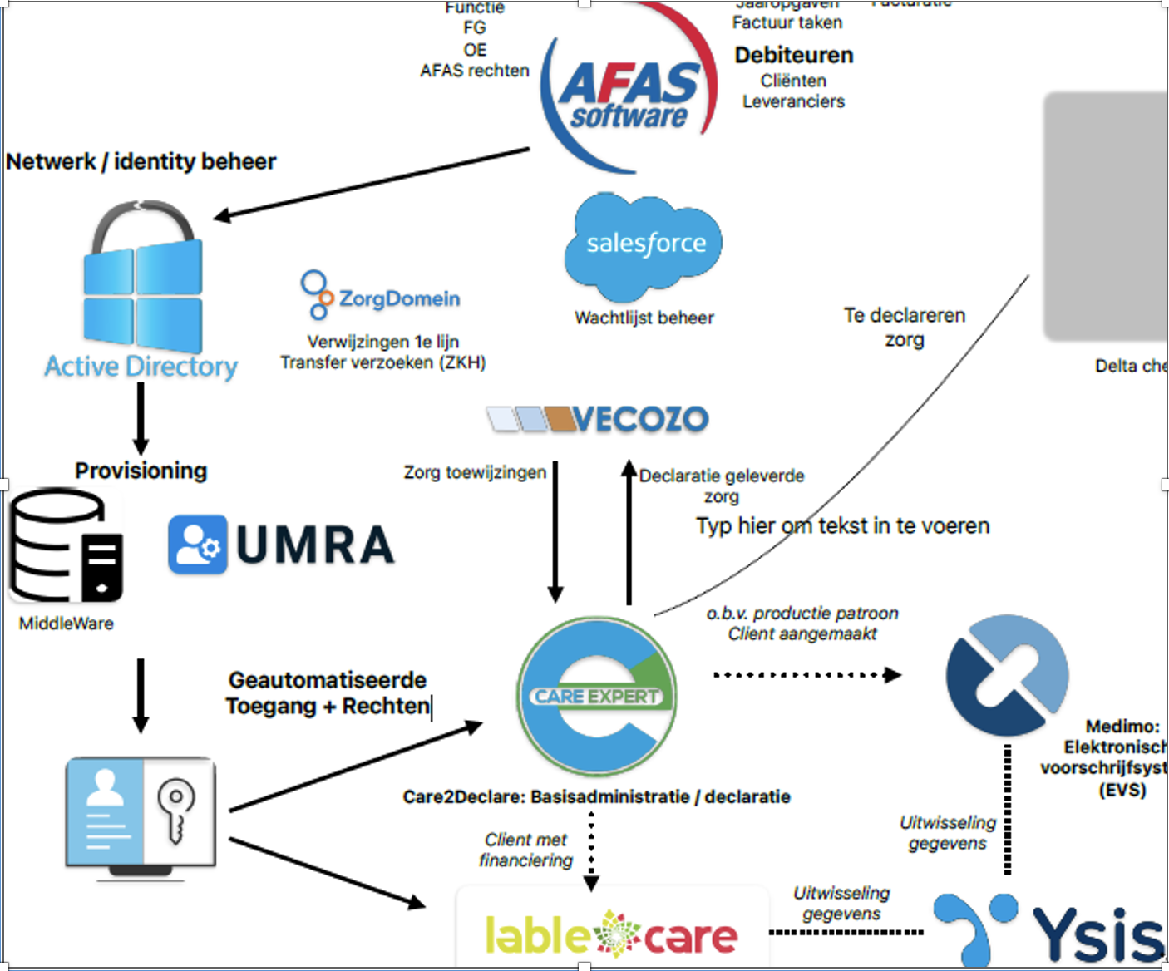
Notes:
What parts of this picture is relevant for us?
Is this the expected carehome flowchart or does it already exist?

Slide 2
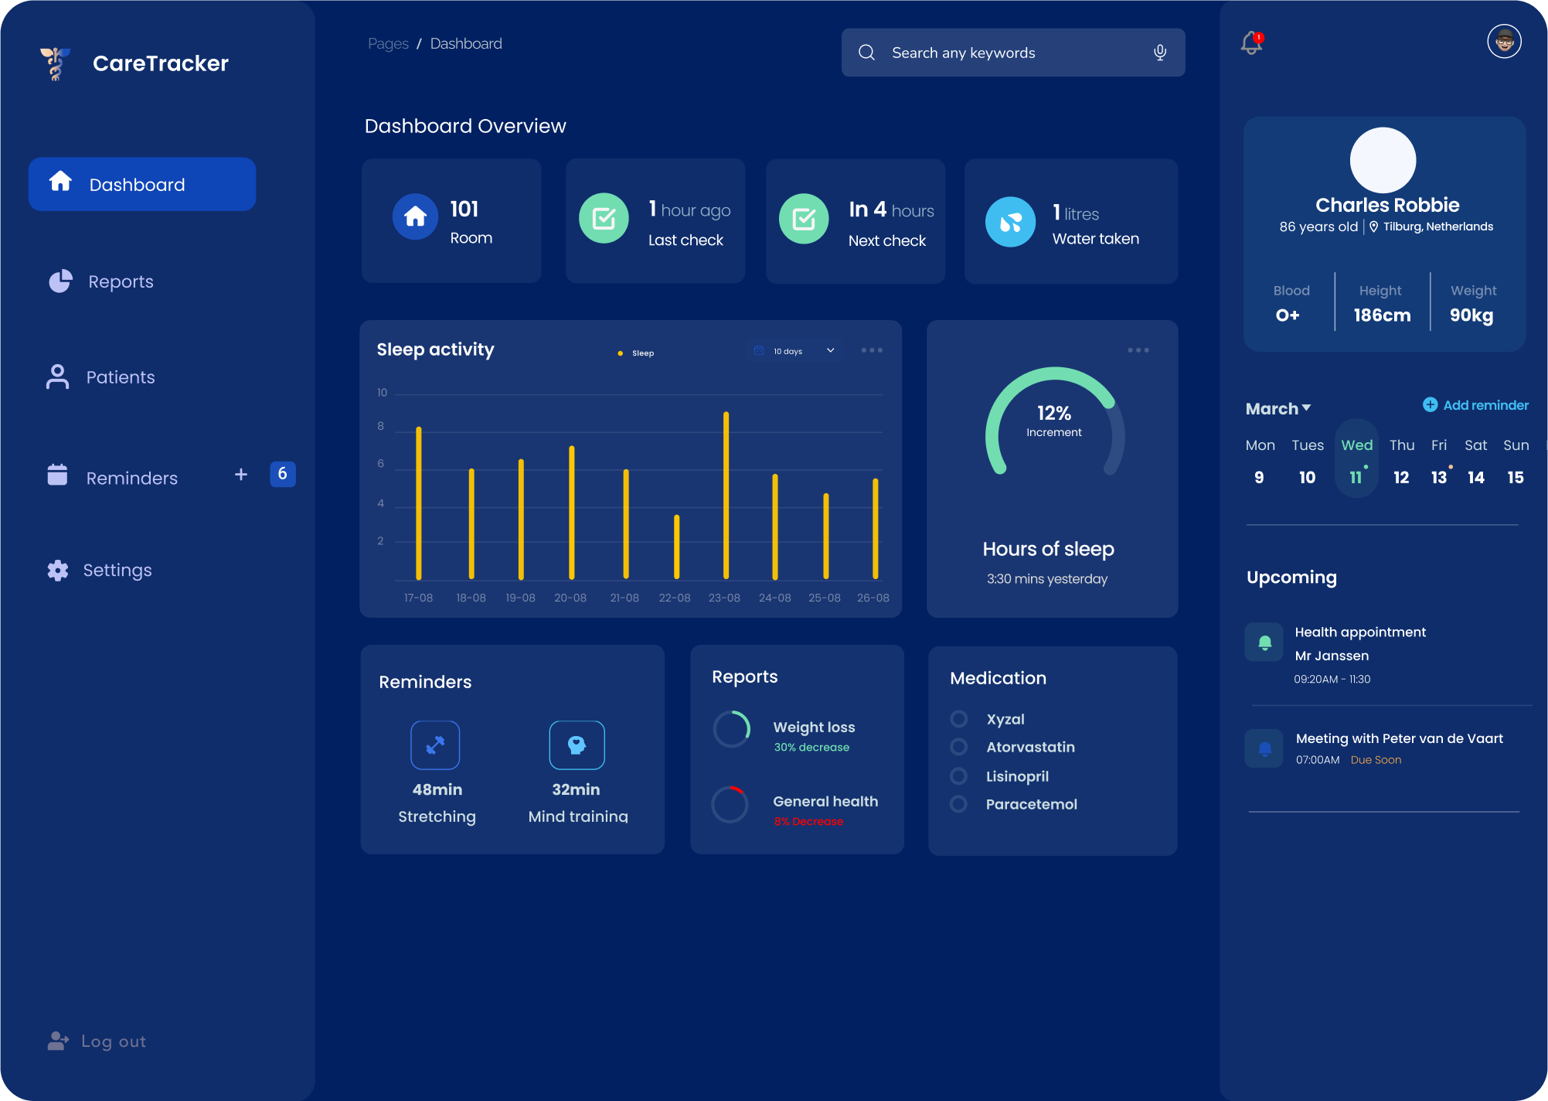
Notes:
Does sensor data end up in ECD?
Who will use the dashboard?
Should the AI accuracy be displayed on the dashboard?
In what language should the documentation be?

Slide 3
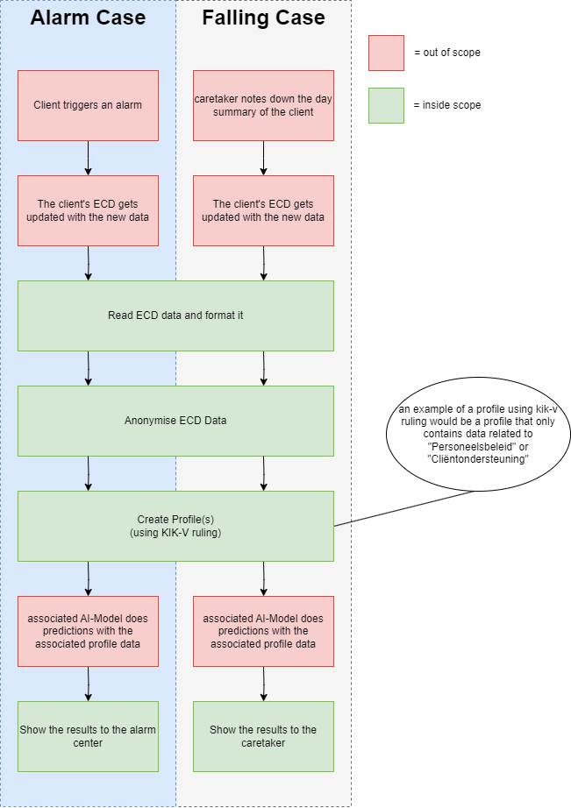
Notes:
Validate flowcharts

Slide 4
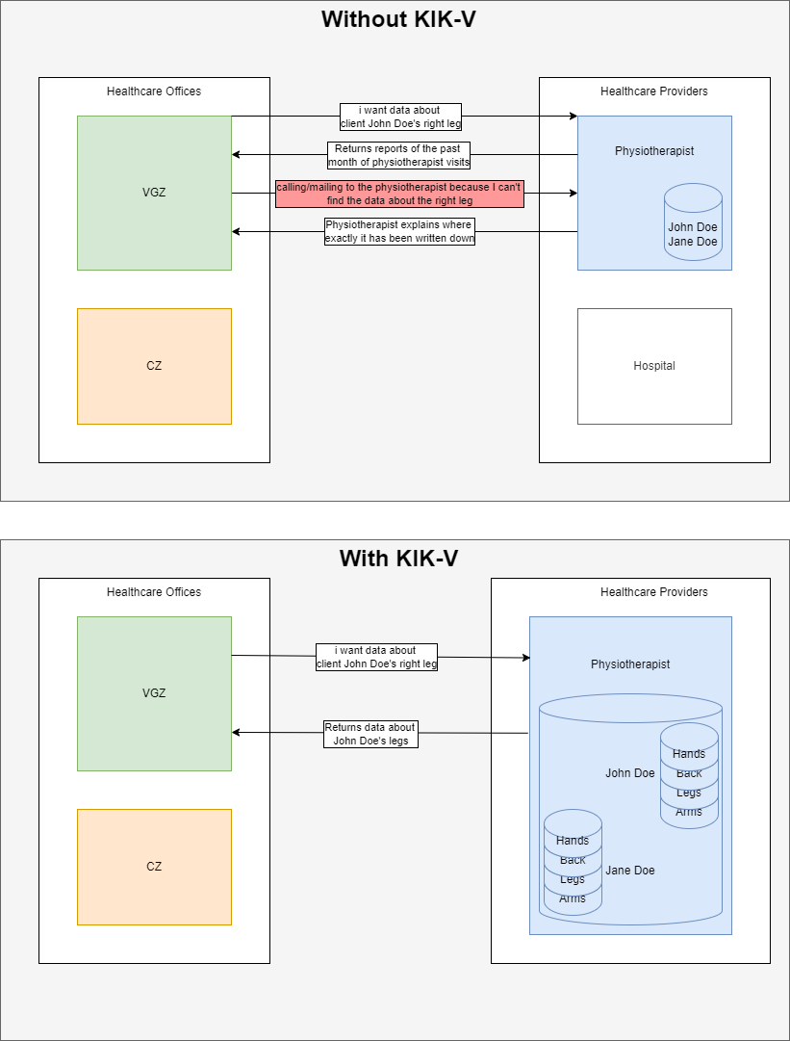
Notes:
- To understand KIK-V better we made a brief example, and we would like to validate if this is correct?
Who will structure the data and organise it? (not KIK-V right?)

